Slide 1
Special Education Cohort Program:
Payment FAQs
Division of Special Education and disAbility Research

Slide 2
Table of Contents
Why is there a financial hold on my account, and what does that mean?
Why am I having trouble paying for my class?
Where can I find messages from my program?
What happens in the event of inclement weather?
How can I protect myself if a sudden injury or illness forces me to withdraw?
Bill+Payment & Patriot Web
How do I pay for classes?
Where’s my receipt?
What happens if I register for a class late?
What happens if I don’t pay my tuition or late fees on time?
How do I drop/withdraw from a class?
I withdrew from a class; why do I still owe tuition?
Extended Nonpayment

Slide 3
Do not use Bill+Payment or Patriot Web to pay tuition!
Your tuition balance will not be listed in your student account, Bill + Payment, or Patriot Web. The Special Education Cohort Program does not have access to payments made in these systems.
If you pay through any of these systems, it will be treated as non-payment and subject to late fees.

Slide 4
“How do I pay for classes?”
Payment by Check or Money Order
Payment by Debit or Credit Card
Make checks payable to George Mason University and mail to:
George Mason University
Division of Special Education Outreach Payment Office
4400 University Dr., MSN 1F2
Finley Building 102
Fairfax, VA 22030
Include the student’s name, G#, course/section number, and semester. Checks must be postmarked within 48 hours of the first scheduled night of class.
To pay online, visit our online payment site, Touchnet.
Choose the category of your payment (your school system, Internship, Late Fees, etc.), then choose your course/ fee and complete all prompted information fields.

Slide 5
“Where’s my receipt?”
You will not receive an invoice from this program – only a receipt.
Receipts for online payment will be sent to the email you provided during checkout. The email will be from specepay@gmu.edu. Check your spam or junk folder.
Receipts for check payments can be requested via email to specepay@gmu.edu.
You must wait two weeks after the check has been deposited by the school and cleared your bank. The tuition must have been paid in full, including any late fees.

Slide 6
“What happens if I register for a class late?”
Students have 48 hours from the scheduled start of class to either:
Submit their Registration forms, or
Enroll on Blackboard.
After 48 hours, a late registration fee of $100 will be assessed.
This 48-hour deadline does not change if the class is canceled due to inclement weather or other rescheduling.

Slide 7
“What happens if I don’t pay my tuition on time?”
Students have 48 hours from the scheduled start of class to pay tuition in full (except for Internships and Practicums, which have other posted deadlines).
After 48 hours, a late fee of $50 per credit will be assessed, and a financial hold will be placed on the student account.
This 48-hour deadline does not change if the class is canceled due to inclement weather or other rescheduling.

Slide 8
“How do I drop/withdraw from a class?”
After the unrestricted withdrawal period, you must submit a withdrawal or drop request.
Learn more about the withdrawal process and submitting a withdrawal request.
The withdrawal request form itself is here: Withdrawal Request PDF.

Slide 9
“I withdrew from a class; why do I still owe tuition?”
If you owe full tuition, you must have withdrawn from the class after the 14-day deadline.
After 14 days from the first class meeting, you will owe full tuition, even if you have not yet paid or have not attended class.

Slide 10
Extended Nonpayment
After 45 days of non-payment, the office will send accounts to the University’s Accounts Management Office to begin the collections process.
Please pay all tuition and fees as soon as possible to avoid collections.

Slide 11
“Why is there a financial hold on my account, and what does that mean?”
A financial hold is placed on a student account for nonpayment of tuition and/or late fees.
A hold prevents a student from enrolling in additional courses, receiving transcripts, or graduating.
Make sure that you have paid all tuition and late fees, and contact the Special Education Payment Office for further information.

Slide 12
“Why am I having trouble paying for my courses?”
Remember, your tuition balance will not be listed in your student accounts, Bill+Payment, or Patriot Web. The Special Education Cohort Program does not have access to payments made in any of these systems.
The Special Education Cohort Program also does not have access to financial aid deposited in student accounts. Please inform the Financial Aid office that you are taking contract courses.
Notify specepay@gmu.edu of all third-party payments (Veterans Benefits, Virginia529, etc.) within 48 hours of the scheduled start of class.

Slide 13
“Why aren’t I getting emails from my program?”
Emails from the program will be sent to your GMU (gmu.edu) email address, so be sure to check it regularly.
If you are having trouble accessing your GMU email account, please contact George Mason University Information Technology Services.
* support@gmu.edu
( 703.993.8870

Slide 14
“What happens in the event of inclement weather?”
Face-to-face class meetings in Fairfax, Loudoun, or Prince William County will not meet in-person if the school district closes or cancels evening activities.
Please contact your instructor and/or check Blackboard for announcements regarding alternate online instruction.
If you are enrolled in a course that meets in a George Mason facility, watch for Mason Alerts sent to your GMU email account or phone.
If inclement weather affects the beginning of the semester, it does not change the final dates for enrollment or payment.

Slide 15
“What happens if a sudden illness or injury forces me to withdraw?”
George Mason University has partnered with GradGuard™ to offer a Tuition Insurance Plan to students.
If your education is disrupted by a sudden illness or injury and you can’t get a full refund on expenses, a GradGuard™ plan may be able to help.
You may purchase tuition insurance at the beginning of each semester.
Learn more at:
GradGuard’s website
877.794.6603

Slide 16
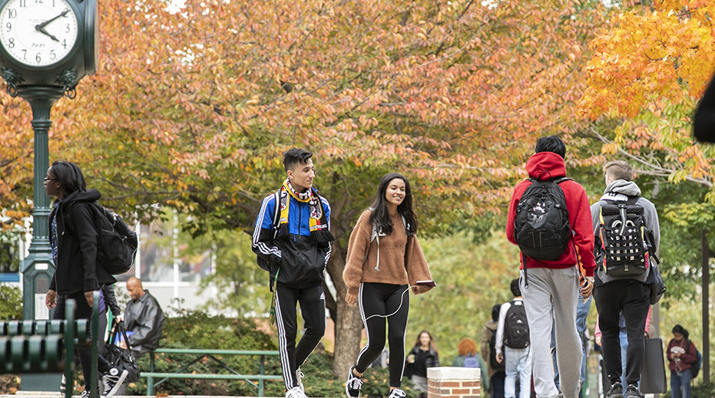
Questions?
COHORT REGISTRATION:
703.993.3670
spedreg@gmu.edu
COHORT PAYMENT:
703.993.6815
specepay@gmu.edu

